Slide 2


Team Members: Brenda Izquierdo, Zeev Feldbeine Product Owner: David Villegas Instructor: Masoud Sadjadi
Introduction Video
May 6th, 2016
Notes:
Greet your audience, thank them for attending your presentation, introduce yourself, introduce your project, introduce your team members, and quickly indicate what each of you did in a high-level manner, and put more emphasis on your part/contribution.

Slide 3
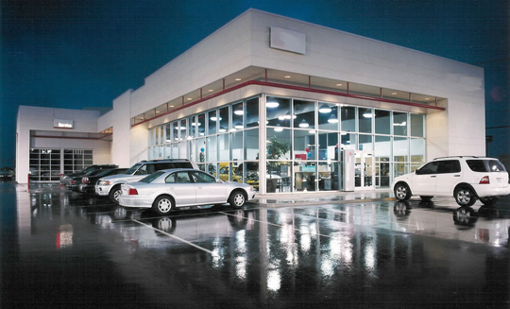

Slide 4
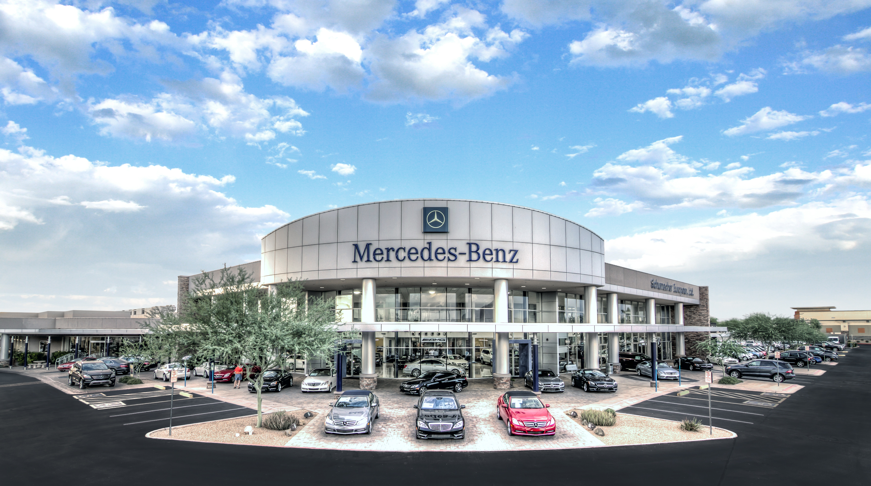

Slide 5


Slide 6





Slide 7

Problem Definition
Time Consuming
Expensive
Inefficient
Problem 1: Shopping for a car takes a lot of time and effort; prospective buyers have to do a lot of research to find the type of car they want.
Problem 2: Selling cars has been made easier than ever thanks to the Internet, however it is still difficult to reach prospective buyers.
Whole Project: The Car Recommendation System(CRS) is a social web application that provides services such as buying, selling and recommending cars based on user behavior.
Notes:
Introduce the problem that the whole project tackles and stay focused on the parts that you have been working. Indicate if there is an existing previous system, enumerate its problems/limitations, etc.

Slide 8
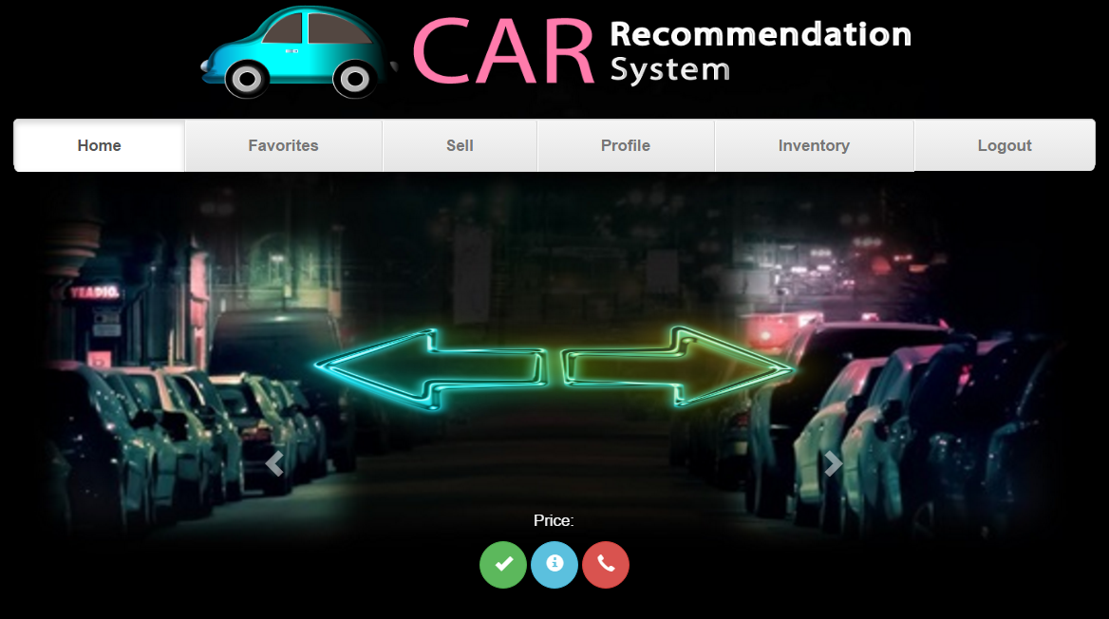

Slide 9
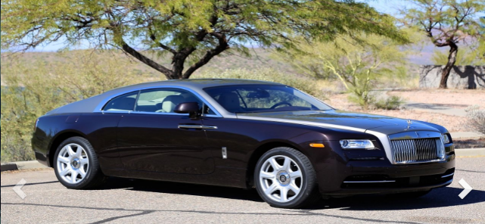

Slide 10


Slide 11
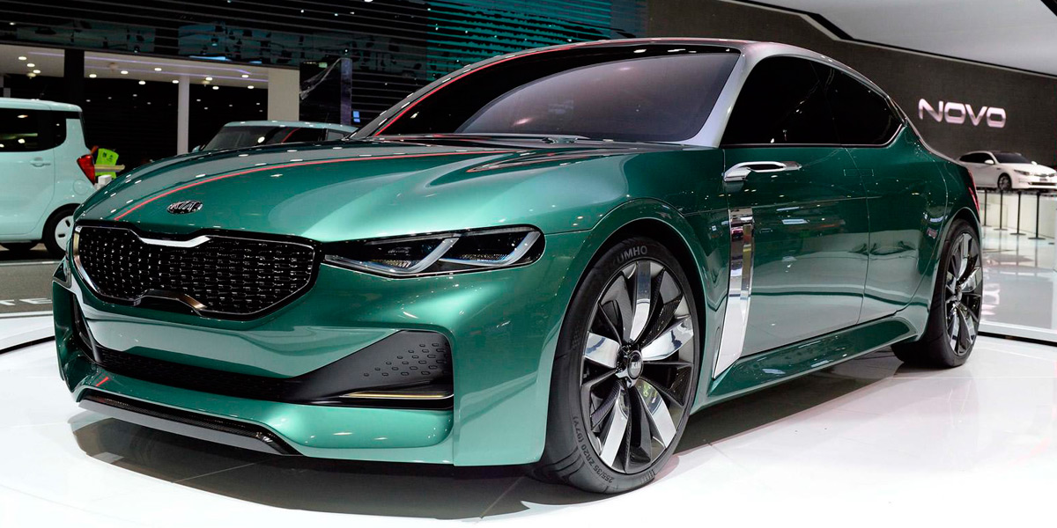

Slide 12
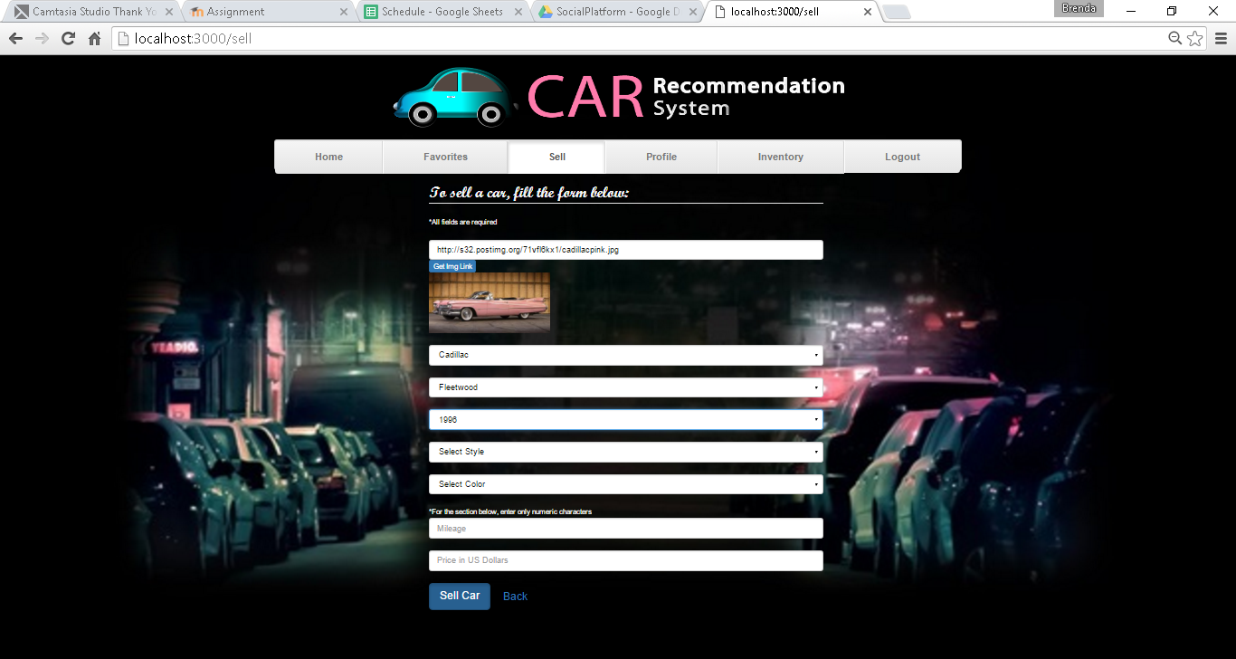

Slide 13
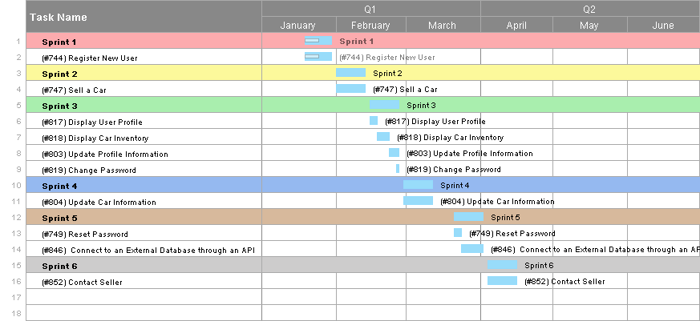
Project Management
Notes:
Project Management (schedule for entire semester) (one slide; Gantt Chart).

Slide 14
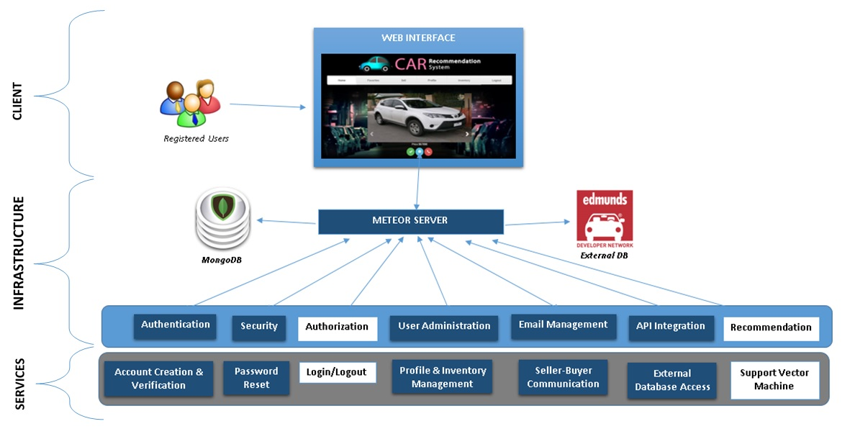
System Design: Architecture
Notes:
5. System design:
5.1. System decomposition; identify the architecture patterns used (one slide).
5.2. System deployment – h/w and s/w requirements (one slide).
5.3. Persistent data design (one slide).
5.4. Security/Privacy (one slide).

Slide 15
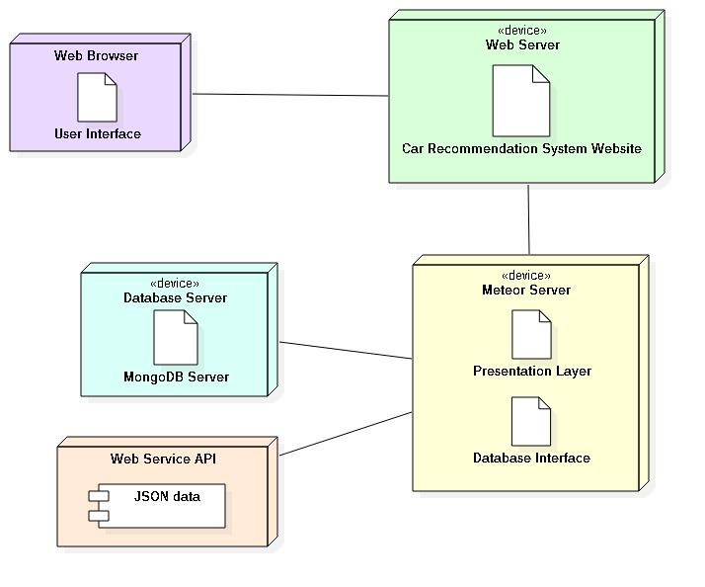
System Design: Deployment
Notes:
5. System design:
5.1. System decomposition; identify the architecture patterns used (one slide).
5.2. System deployment – h/w and s/w requirements (one slide).
5.3. Persistent data design (one slide).
5.4. Security/Privacy (one slide).

Slide 16
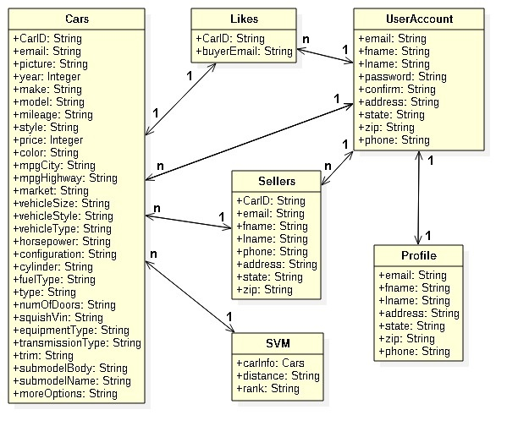
Persistent Data Design
Notes:
5. System design:
5.1. System decomposition; identify the architecture patterns used (one slide).
5.2. System deployment – h/w and s/w requirements (one slide).
5.3. Persistent data design (one slide).
5.4. Security/Privacy (one slide).

Slide 17
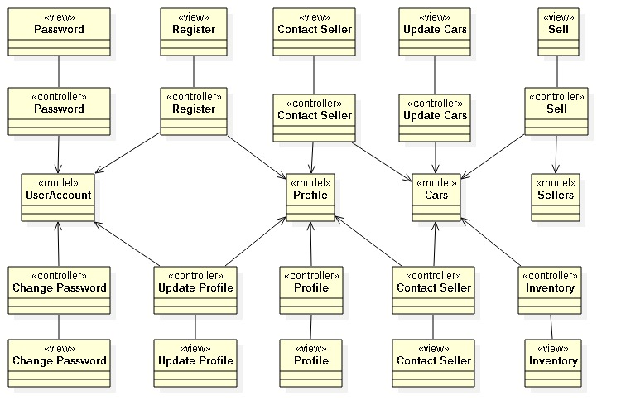
Minimal Class Diagram
Notes:
6. Detailed design:
6.1. Minimal class diagram. Identify the design patterns used (one or more slides).
6.2. State machine for the main control object or the most important object of the implemented uses cases (one or more slides).
6.3. Main algorithm used related to an implemented use case described above (one or more slides).

Slide 19
Summary
The Car Recommendation System is a website that helps users find the perfect car by constantly recommending a best match based on their preferences. It also allows users to sell their cars as well.
Thank you!
Notes:
Summarize your contribution
Include your contact information
Ask if anyone has any questions for you.
Thank your audience

